Slide 1
23MCAC103- ADVANCED OPERATING SYSTEMS
by
Dr.Gobi Natesan

Slide 2
Course Outcome –Unit 1
Compare the different kinds of CPU Scheduling algorithms in an Operating System based on processes arrival time, burst time and Turnaround time.

Slide 3
Syllabus- Unit 1
Fundamentals of Operating Systems:
Computer System organization, Operating System structure, Operating System operations, Operating System Services, System calls, Processes- CPU Scheduling - Case Study

Slide 4
Computer System Structure
Computer system can be divided into four components:
Hardware – provides basic computing resources
CPU, memory, I/O devices
Operating system
Controls and coordinates use of hardware among various applications and users
Application programs – define the ways in which the system resources are used to solve the computing problems of the users
Word processors, compilers, web browsers, database systems, video games
Users
People, machines, other computers

Slide 5
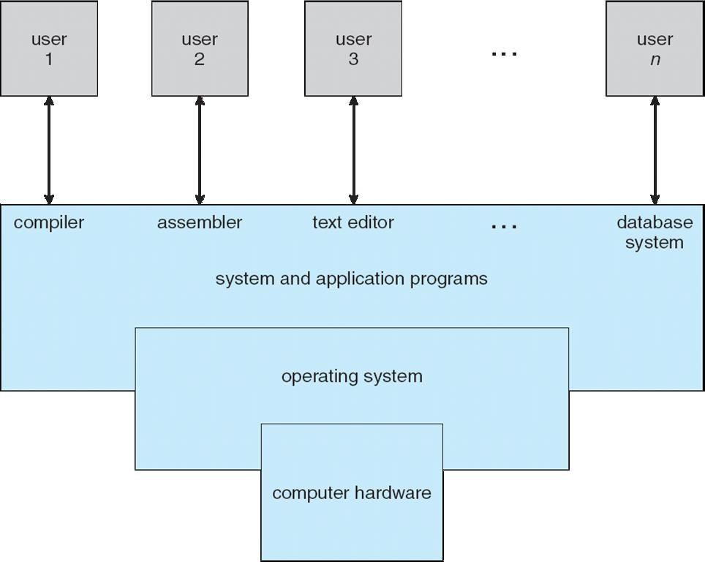
Four Components of a Computer System

Slide 6
Operating System-Definition
A program that acts as an intermediary between a user of a computer and the computer hardware
Operating system goals:
Execute user programs and make solving user problems easier
Make the computer system convenient to use
Use the computer hardware in an efficient manner

Slide 7
Operating System Definition
OS is a resource allocator
Manages all resources
Decides between conflicting requests for efficient and fair resource use
OS is a control program
Controls execution of programs to prevent errors and improper use
of the computer

Slide 8
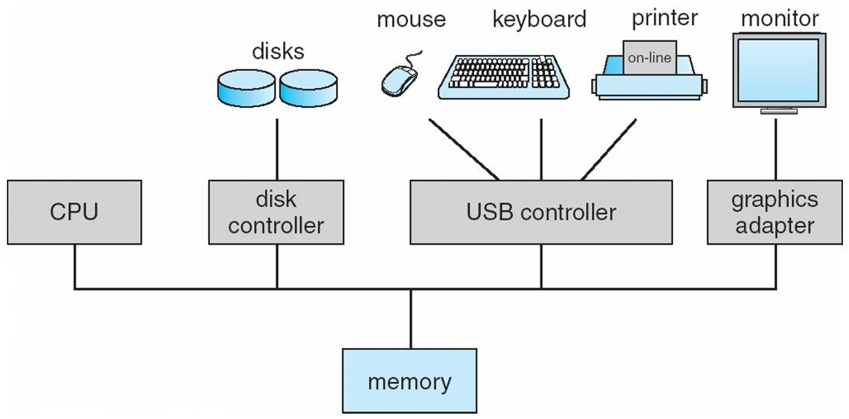
Computer System Organization
Computer-system operation
One or more CPUs, device controllers connect through common bus providing access to shared memory
Concurrent execution of CPUs and devices competing for memory cycles

Slide 9
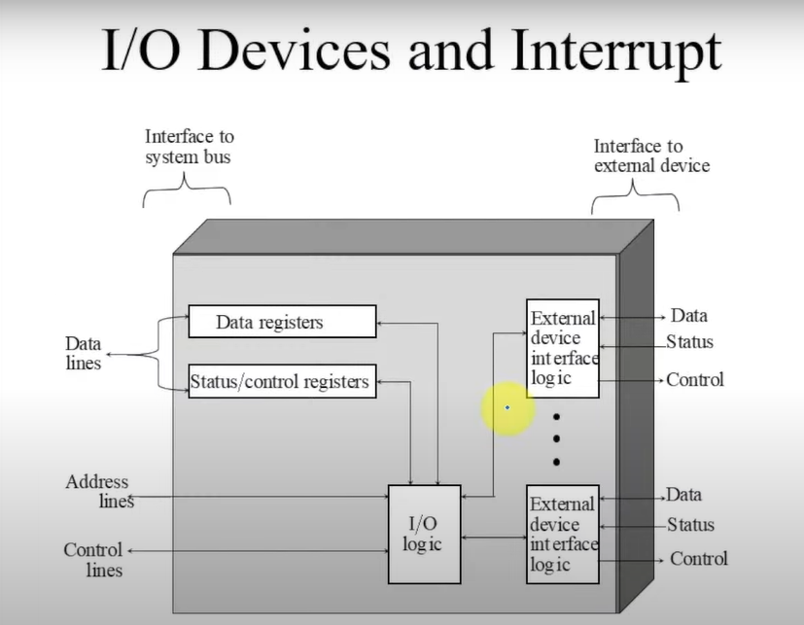

Slide 10
Computer-System Operation
I/O devices and the CPU can execute concurrently
Each device controller is in charge of a particular device type
Each device controller has a local buffer
CPU moves data from/to main memory to/from local buffers
I/O is from the device to local buffer of controller
Device controller informs CPU that it has finished its operation by causing an interrupt

Slide 11
Common Functions of Interrupts
Interrupt transfers control to the interrupt service routine generally, through the interrupt vector, which contains the addresses of all the service routines.
Interrupt architecture must save the address of the interrupted instruction.
A trap or exception is a software-generated interrupt caused either by an error or a user request.
An operating system is interrupt driven.

Slide 12
Interrupt Handling
The operating system preserves the state of the CPU by storing registers and the program counter
Determines which type of interrupt has occurred:
polling
vectored interrupt system
Separate segments of code determine what action should be taken for
each type of interrupt

Slide 13
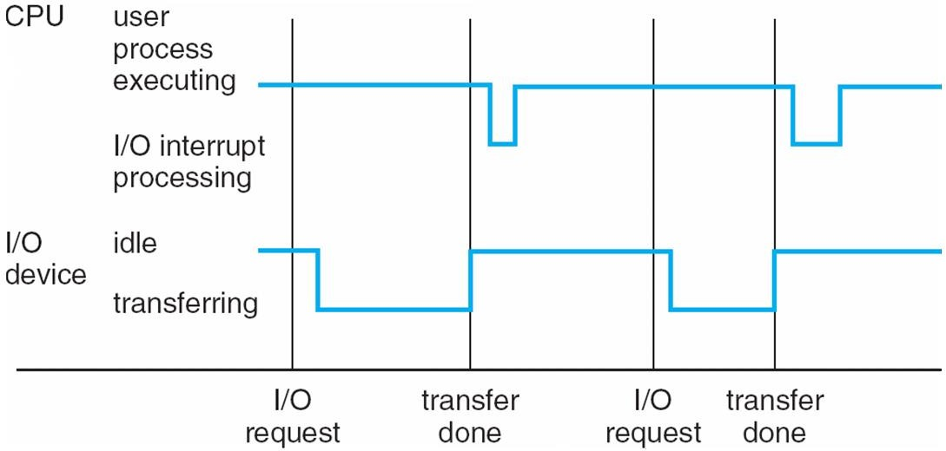
Interrupt Timeline

Slide 14
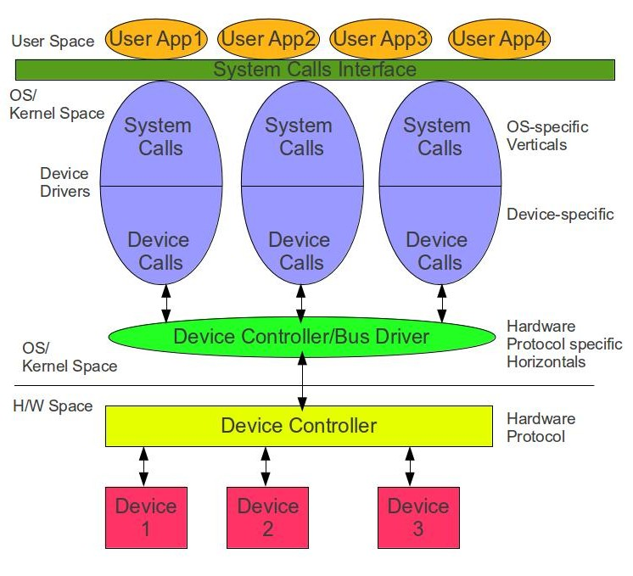

Slide 15
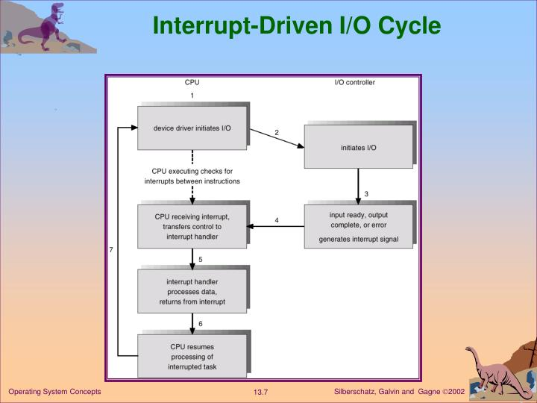

Slide 16
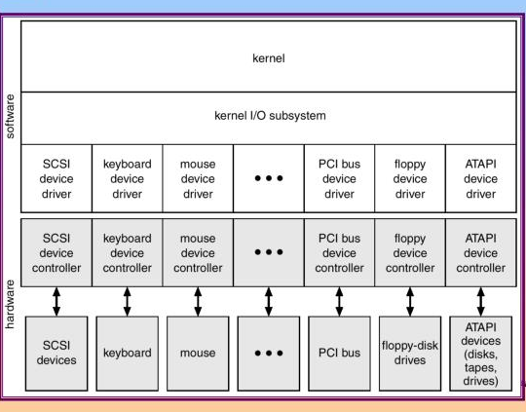

Slide 17
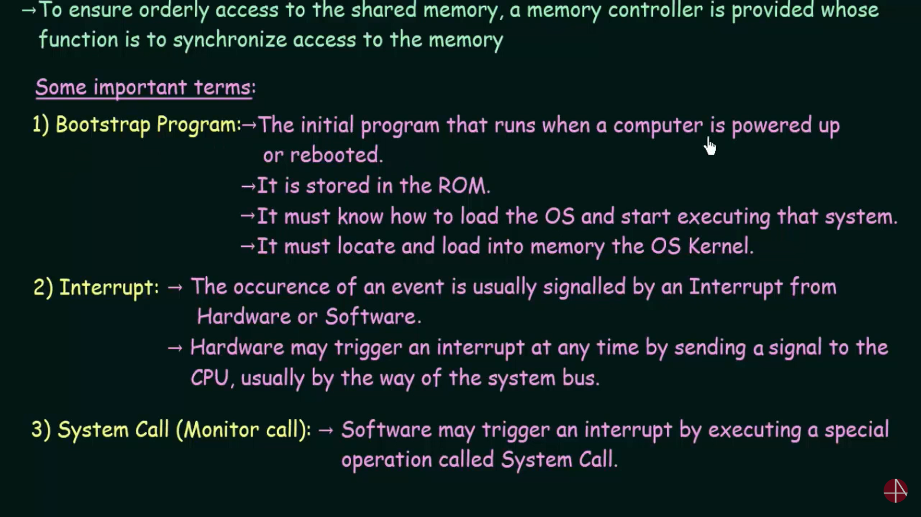

Slide 18
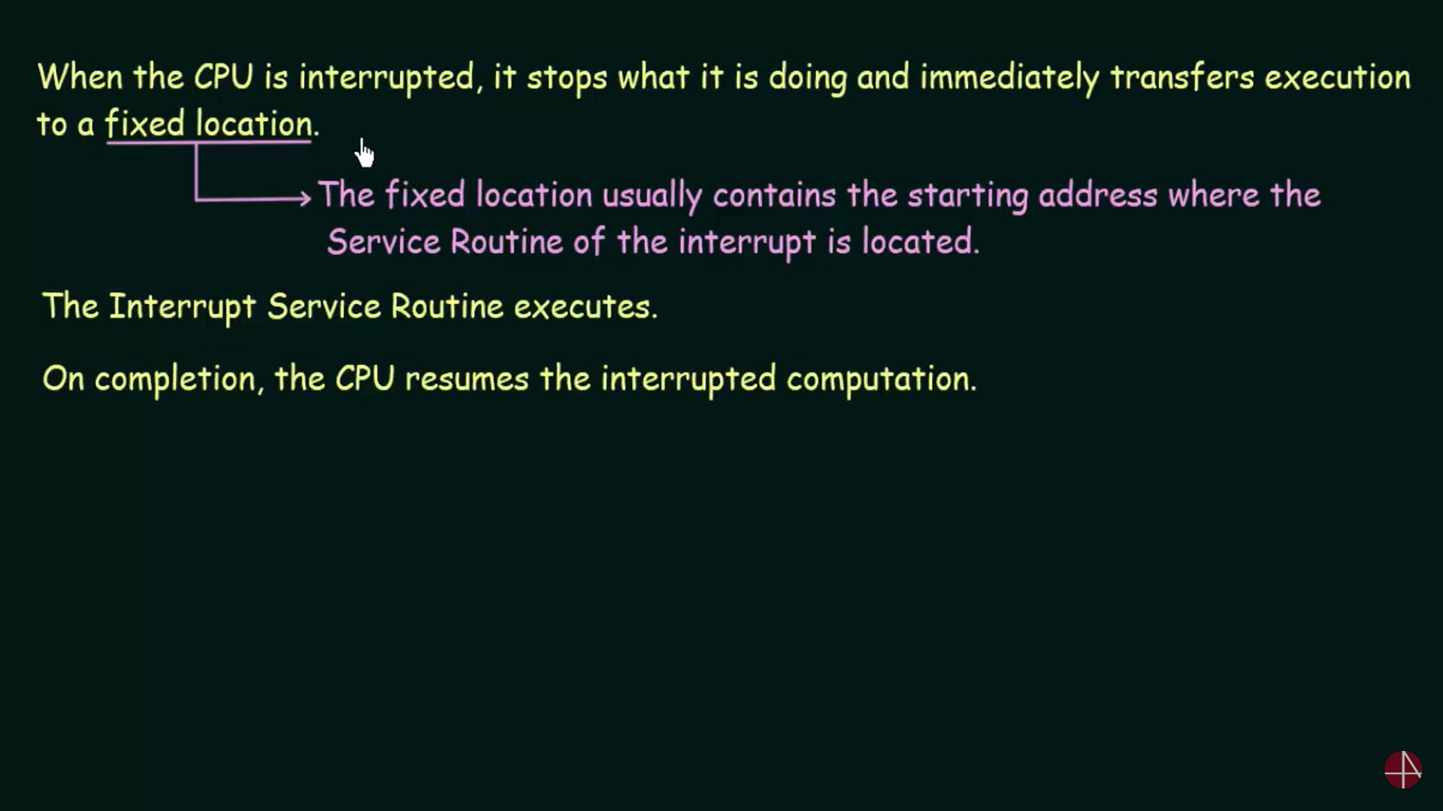

Slide 19
Byte Storage Notations
Metric | Value | Bytes
Byte (B) | 1 | 1
Kilobyte (KB) | 1,024¹ | 1,024
Megabyte (MB) | 1,024² | 1,048,576
Gigabyte (GB) | 1,024³ | 1,073,741,824
Terabyte (TB) | 1,024⁴ | 1,099,511,627,776
Petabyte (PB) | 1,024⁵ | 1,125,899,906,842,624
Exabyte (EB) | 1,024⁶ | 1,152,921,504,606,846,976
Zettabyte (ZB) | 1,024⁷ | 1,180,591,620,717,411,303, 424
Yottabyte (YB) | 1,024⁸ | 1,208,925,819,614,629,174,706,176

Slide 20
Storage Structure
Main memory – only large storage media that the CPU can access directly
Random access
Typically volatile
Secondary storage – extension of main memory that provides large
nonvolatile storage capacity
Magnetic disks – rigid metal or glass platters covered with magnetic recording material
Disk surface is logically divided into tracks, which are subdivided into sectors
The disk controller determines the logical interaction between the device and the computer

Slide 21
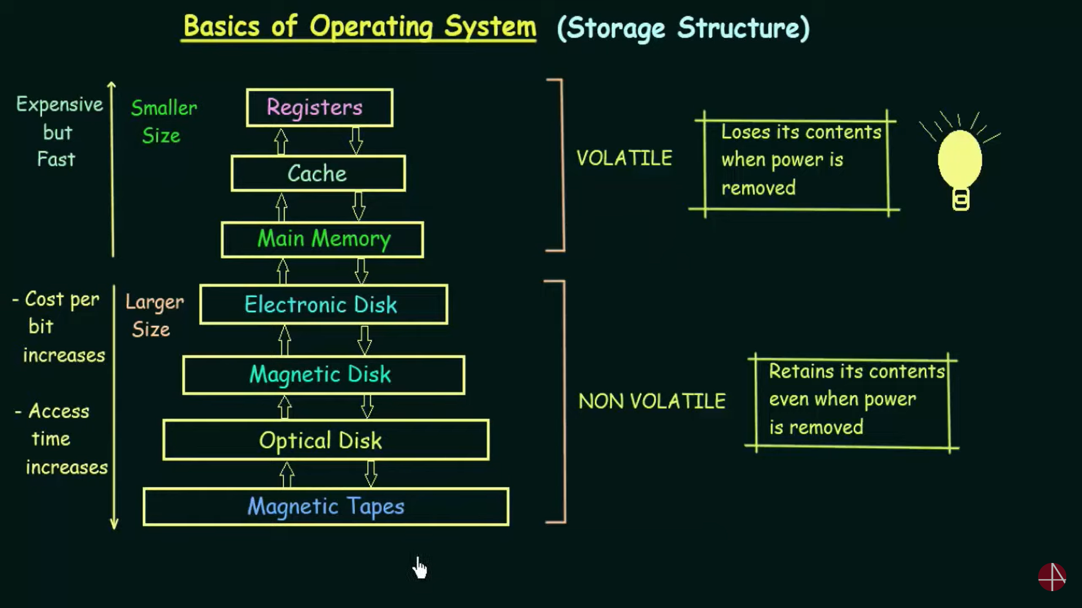

Slide 22
Storage Hierarchy
Storage systems organized in hierarchy
Speed
Cost
Volatility
Caching – copying information into faster storage system; main memory can be viewed as a cache for secondary storage
Device Driver for each device controller to manage I/O
Provides uniform interface between controller and kernel

Slide 23
Caching
Important principle, performed at many levels in a computer (in hardware, operating system, software)
Information in use copied from slower to faster storage temporarily
Faster storage (cache) checked first to determine if information is there
If it is, information used directly from the cache (fast)
If not, data copied to cache and used there
Cache smaller than storage being cached
Cache management important design problem
Cache size and replacement policy

Slide 24
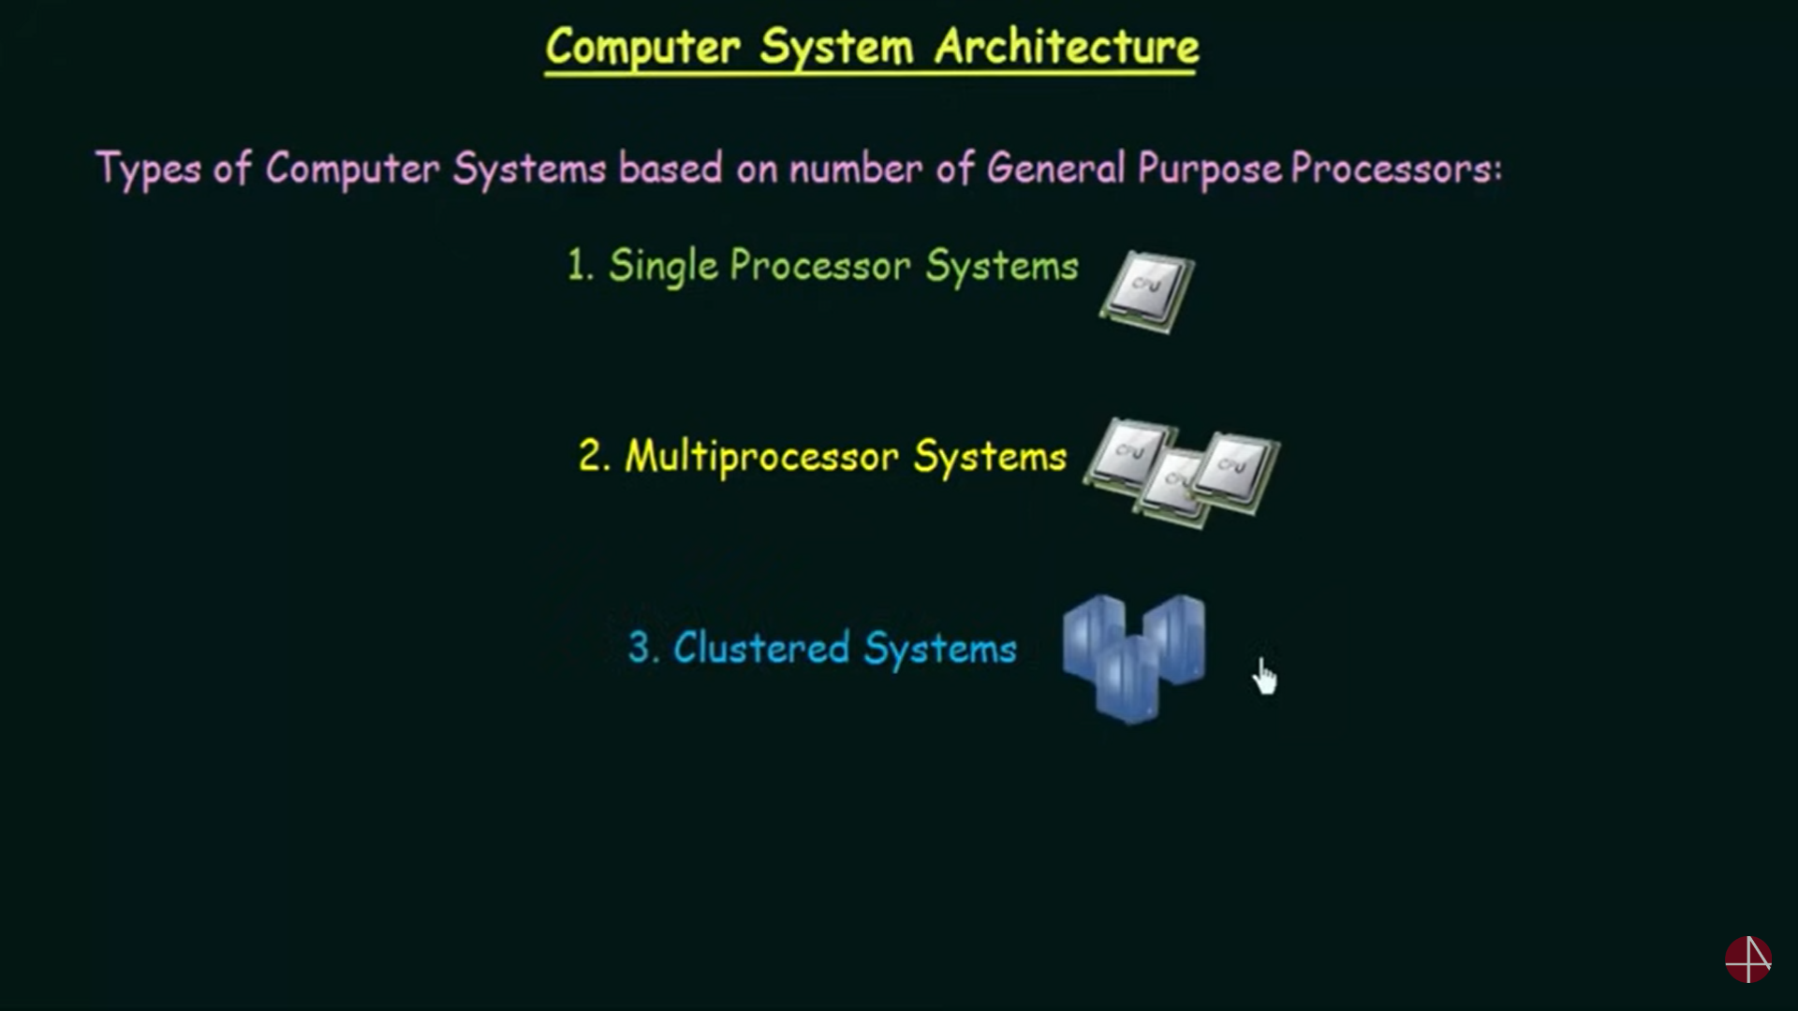

Slide 25
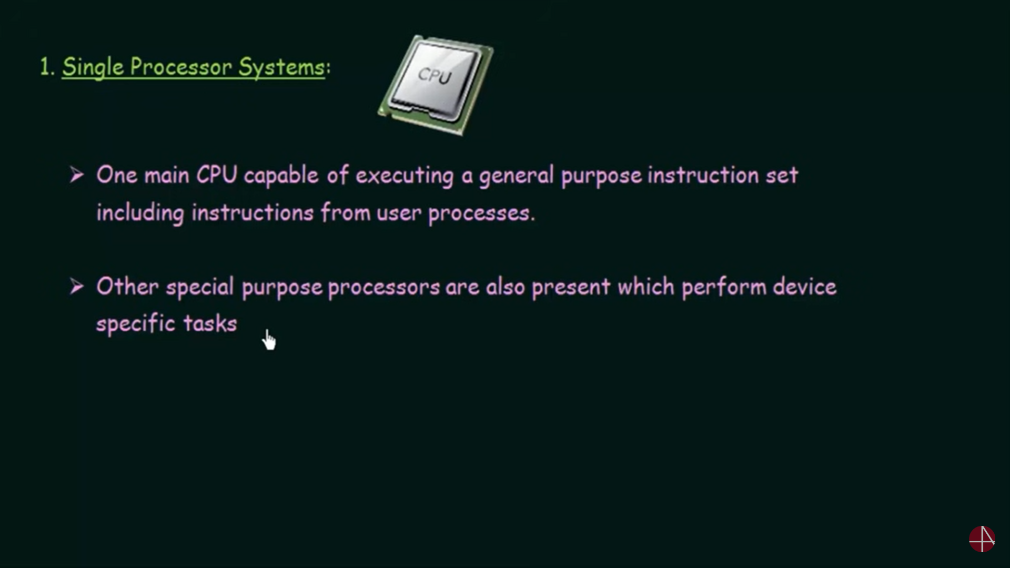

Slide 26
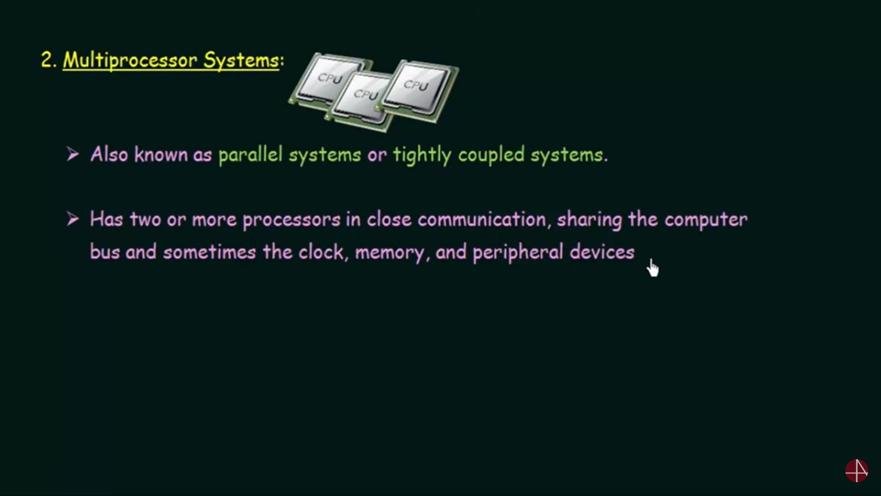

Slide 27
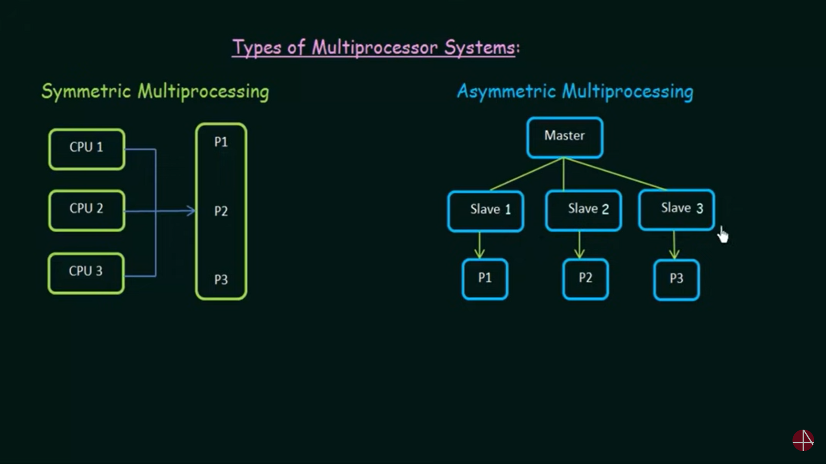

Slide 28
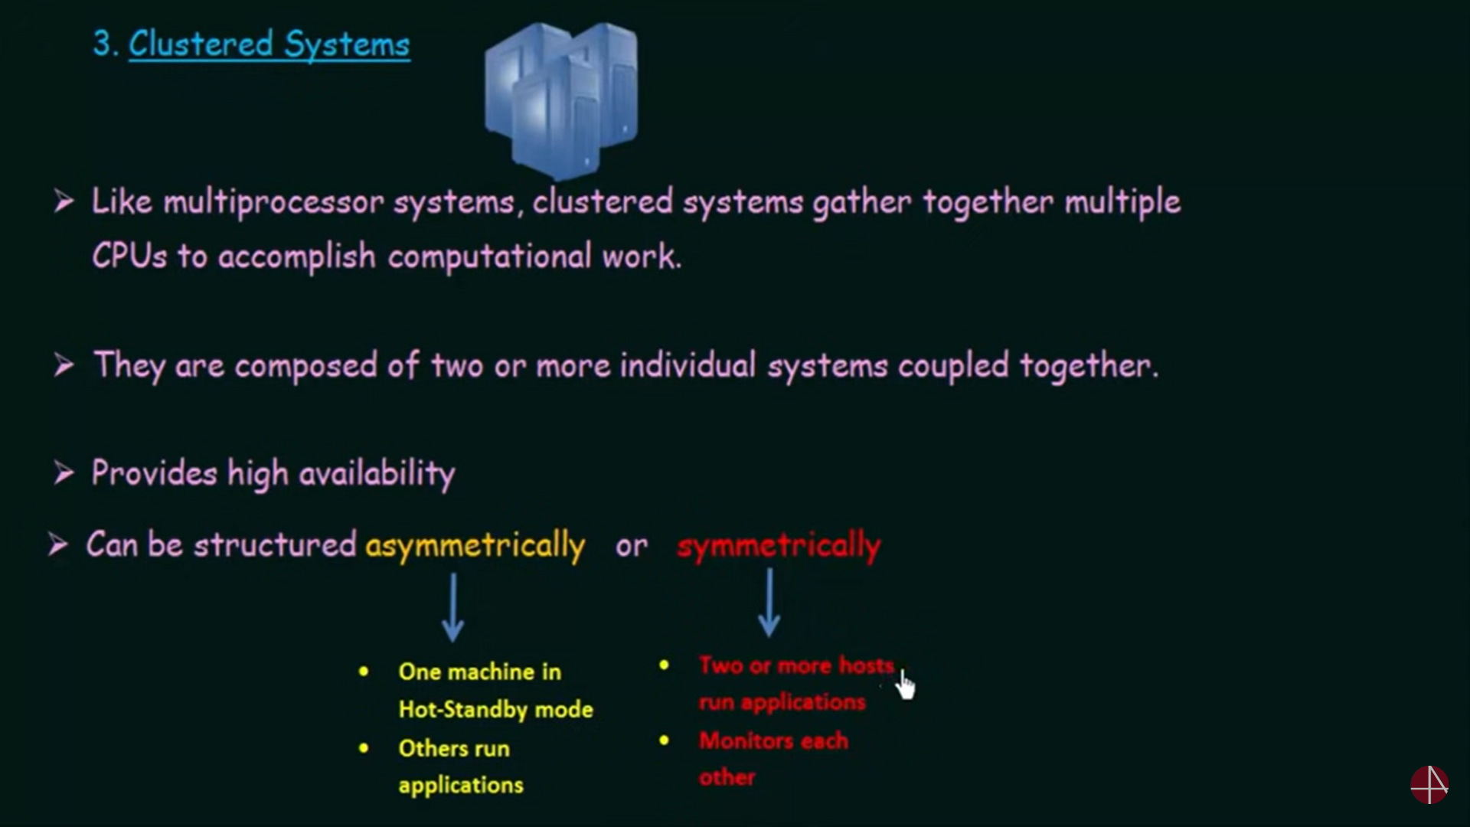

Slide 29
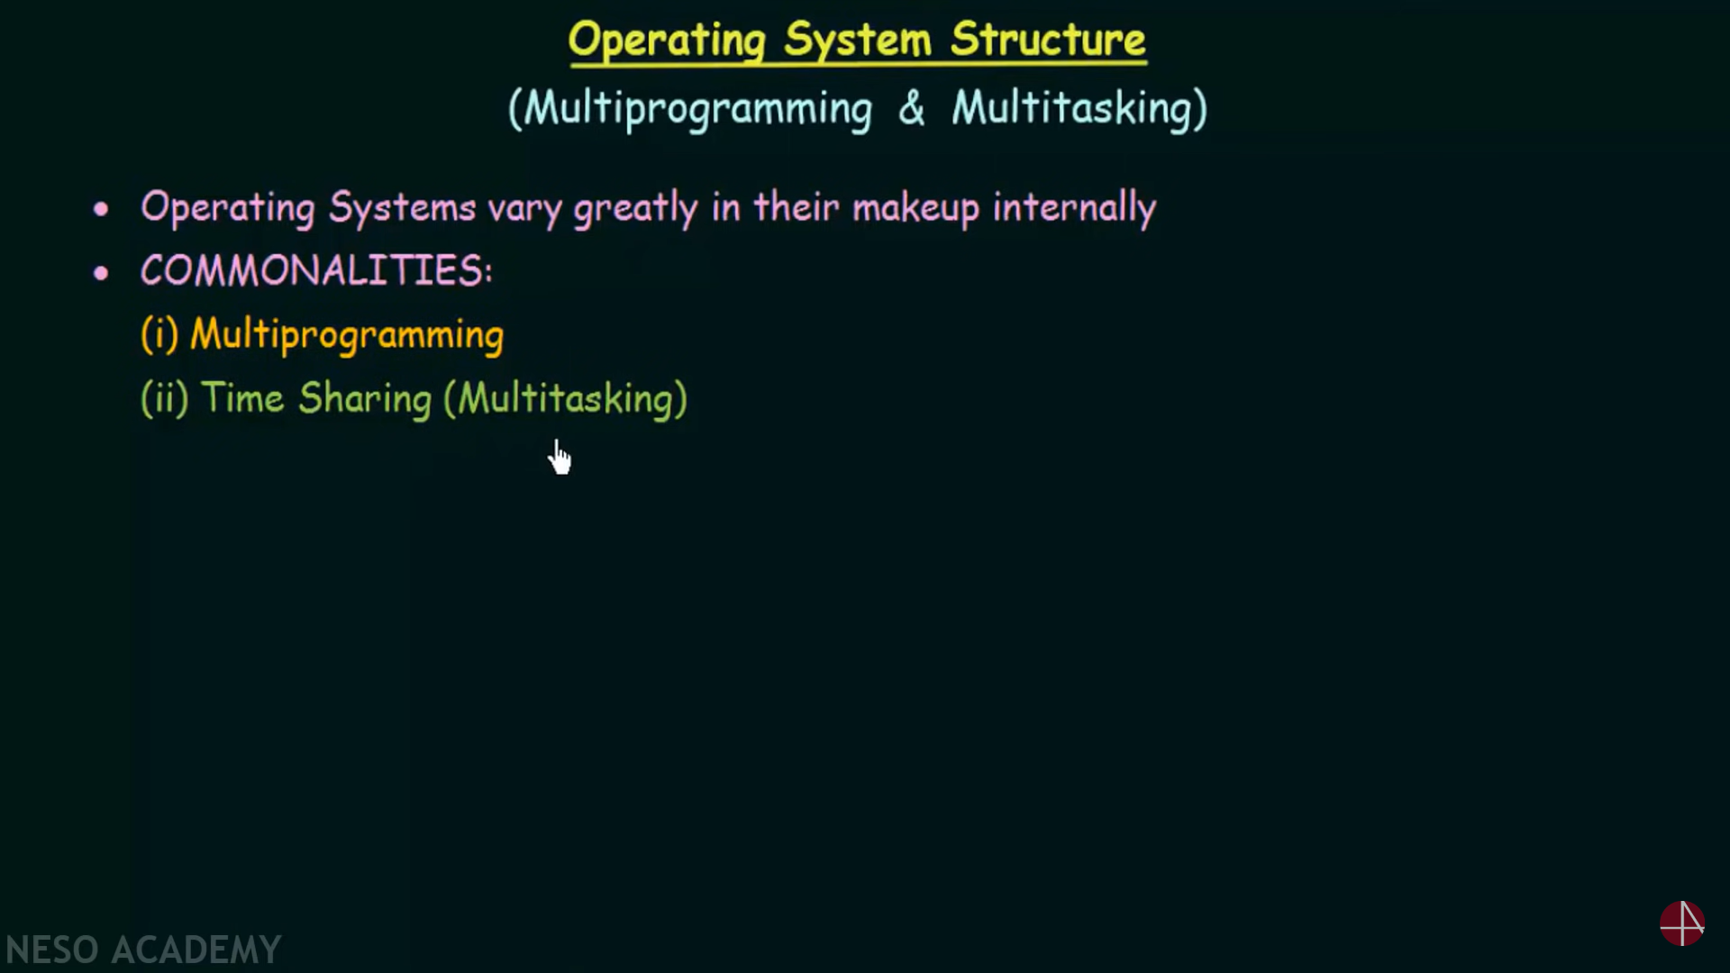

Slide 30
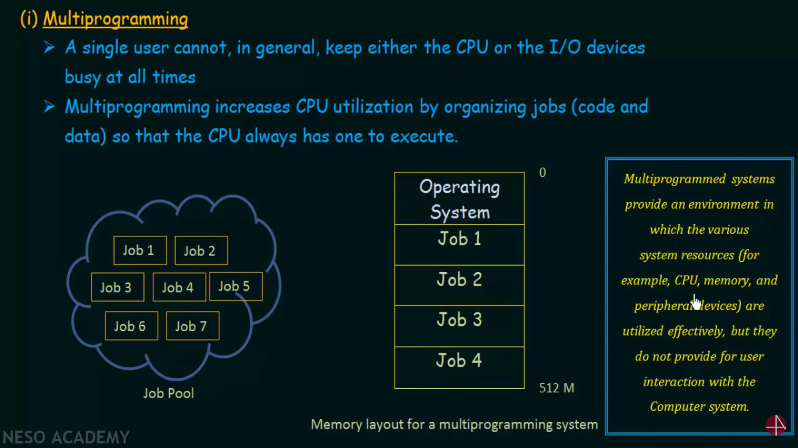

Slide 31
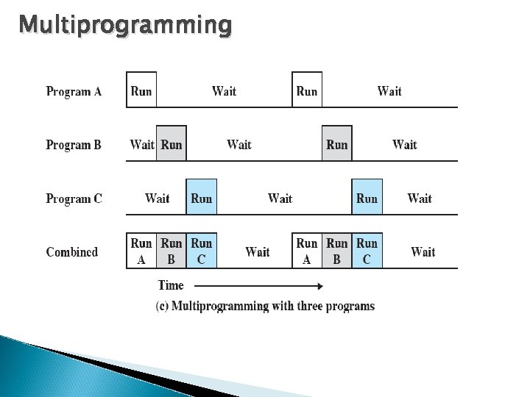

Slide 32
Multiprogramming
Multiprogramming needed for efficiency
A subset of total jobs in system is kept in memory
One job selected and run via job scheduling
When it has to wait (for I/O for example), OS switches to another job

Slide 33
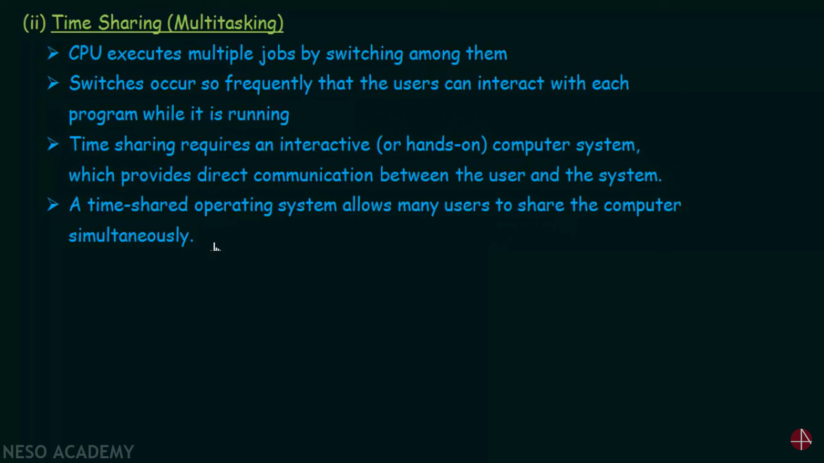

Slide 34
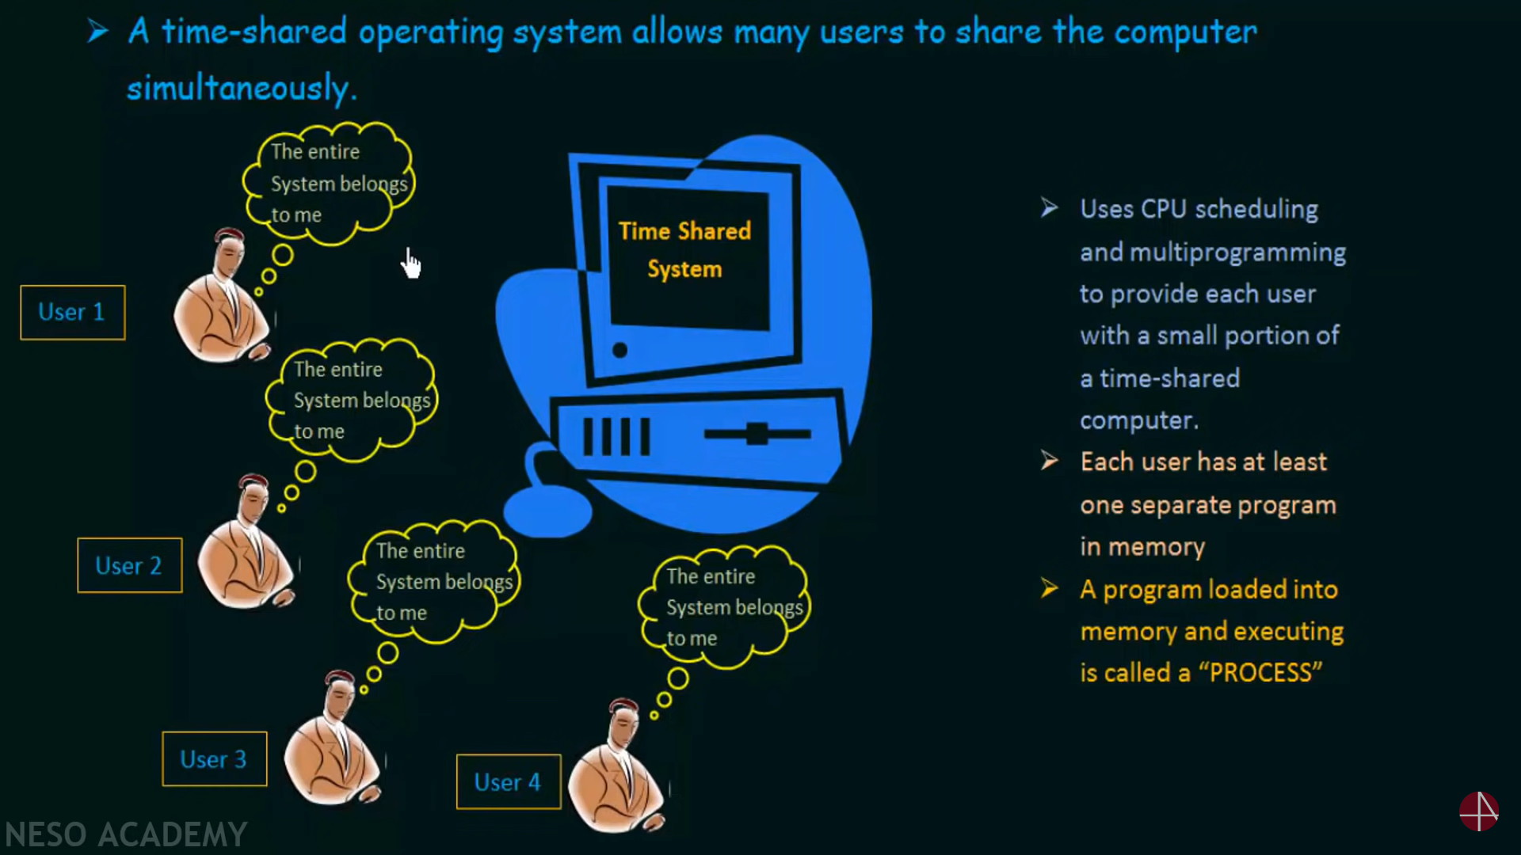

Slide 35
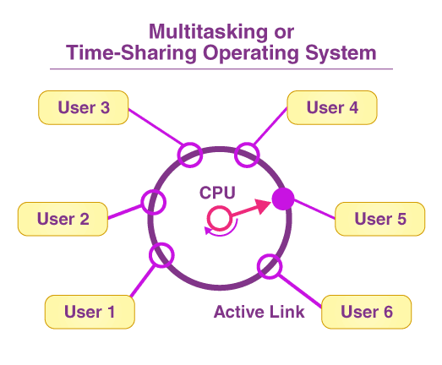

Slide 36
Multitasking
Timesharing (multitasking) is logical extension in which CPU switches jobs so frequently that users can interact with each job while it is running, creating interactive computing
Response time should be < 1 second
Each user has at least one program executing in memory -process
If several jobs ready to run at the same time - CPU scheduling
If processes don’t fit in memory, swapping moves them in and out to run
Virtual memory allows execution of processes not completely in memory

Slide 37
Operating-System Operations
Modern operating systems are interrupt driven.
When there is no process, no I/O routine, no user → CPU Utilization is Zero ie. System is in Idle State.
A trap (or an exception) is a software-generated interrupt caused either by an error

Slide 39
The interrupt-driven nature of an operating system defines that system’s general structure.
For each type of interrupt, separate segments of code in the operating system determine what action should be taken.
An interrupt service routine is provided to deal with the interrupt.

Slide 40
User request the OS to perform some services/Operations.
Two Modes of Operations :
Dual Mode Operations
Timer based Operations

Slide 41
DUAL-MODE AND MULTIMODE OPERATION
In order to ensure the proper execution of the operating system, we must be able to distinguish between the execution of operating-system code and user defined code.
Approach taken by most computer systems is to provide hardware support that allows us to differentiate among various modes of execution

Slide 42
Two separate modes of operation: user mode and kernel mode (also called supervisor mode, system mode, or privileged mode).
A bit, called the mode bit, is added to the hardware of the computer to indicate the current mode: kernel (0) or user (1).
With the mode bit, we can distinguish between a task that is executed on behalf of the operating system and one that is executed on behalf of the user.

Slide 43
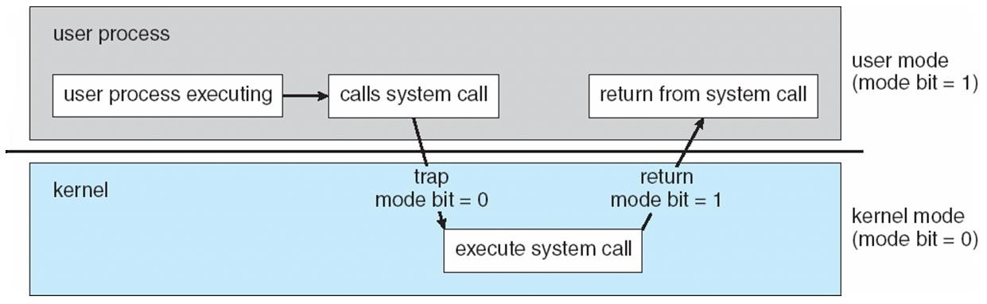
Transition from User to Kernel Mode
When user switched on the system, it is in Kernel mode later user mode.

Slide 44
Timer
Timer to prevent infinite loop / process hogging resources
Set interrupt after specific period
Operating system decrements counter
When counter zero generate an interrupt
Set up before scheduling process to regain control or terminate program that exceeds allotted time

Slide 45
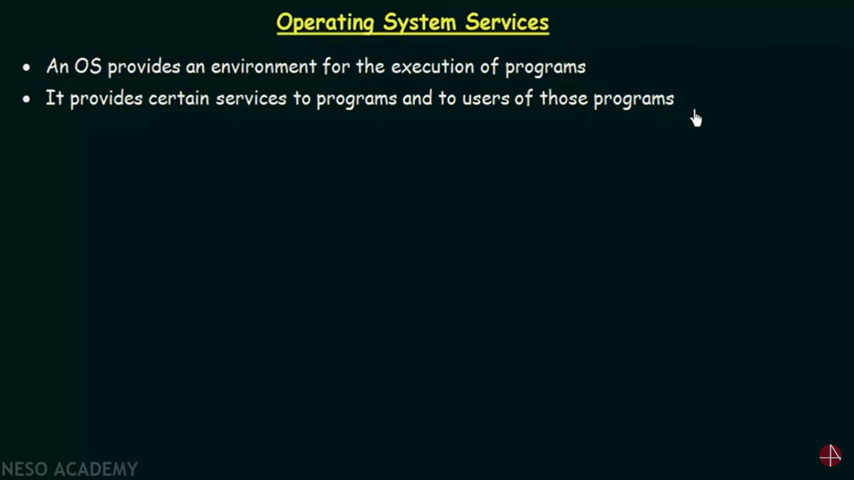

Slide 46
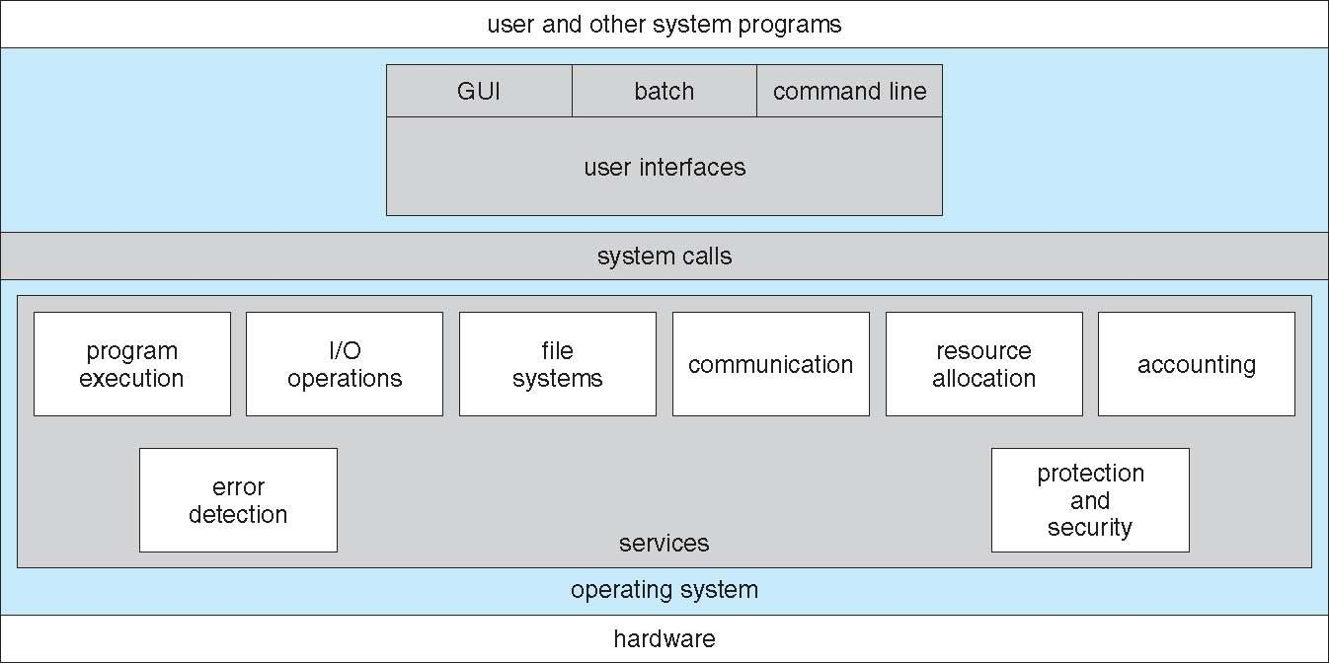

Slide 47
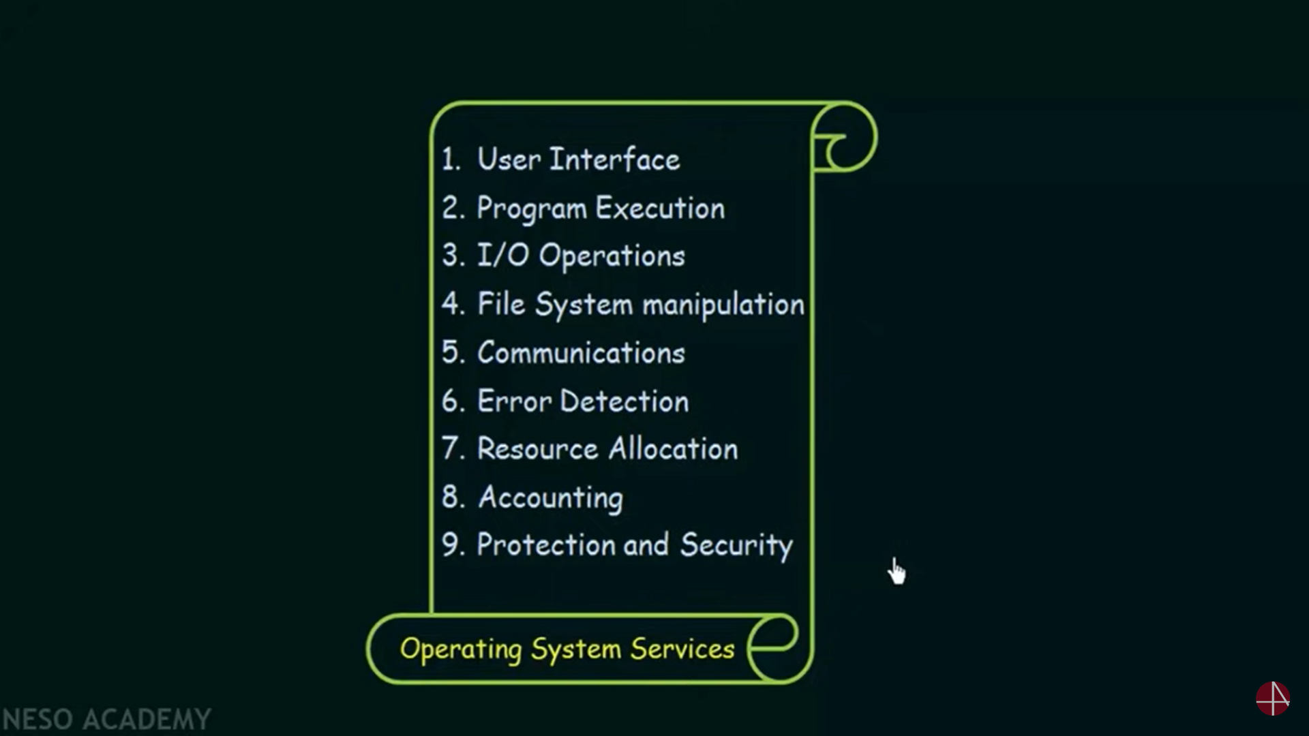

Slide 48
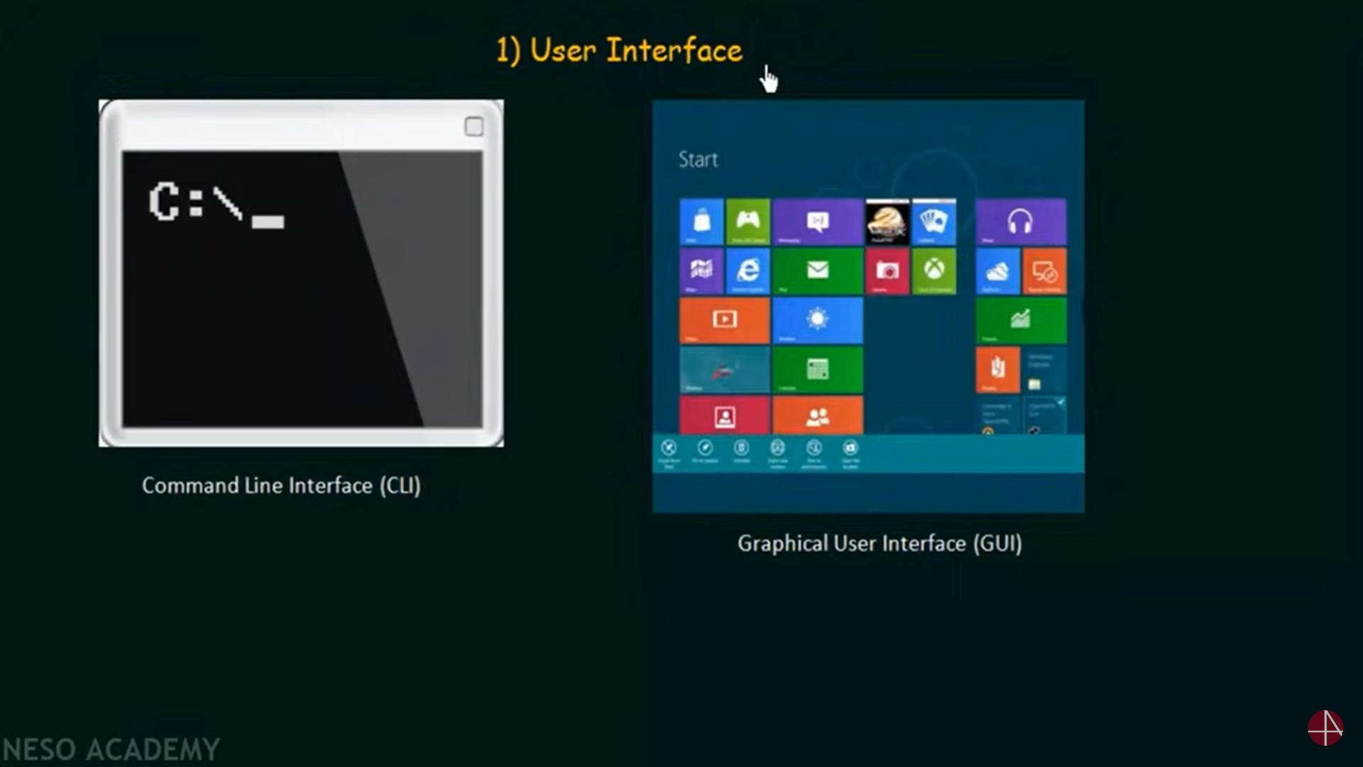

Slide 49
User Interface
Most operating systems have a user interface (UI).
Command-line (CLI), Graphics User Interface (GUI), or batch

Slide 50
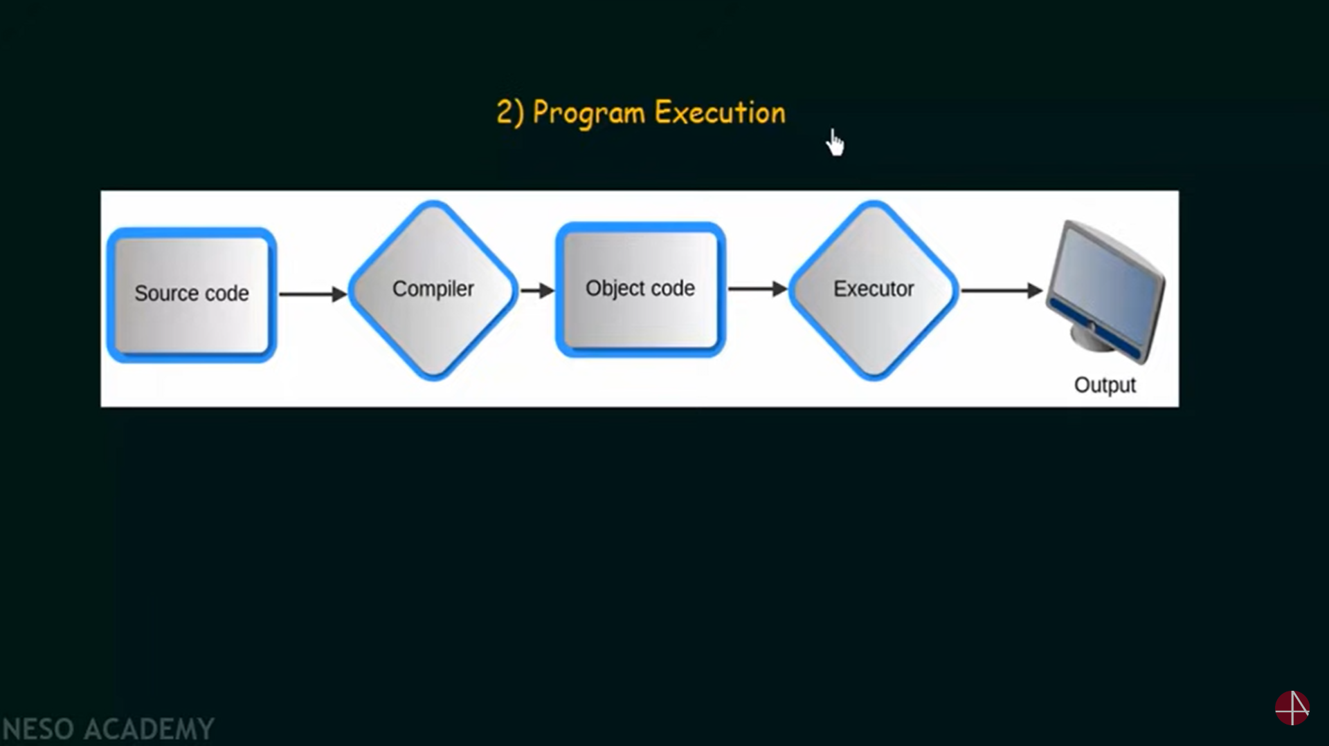

Slide 51
Program Execution
Load and execute an program in the memory
End execution, either normally or abnormally

Slide 52
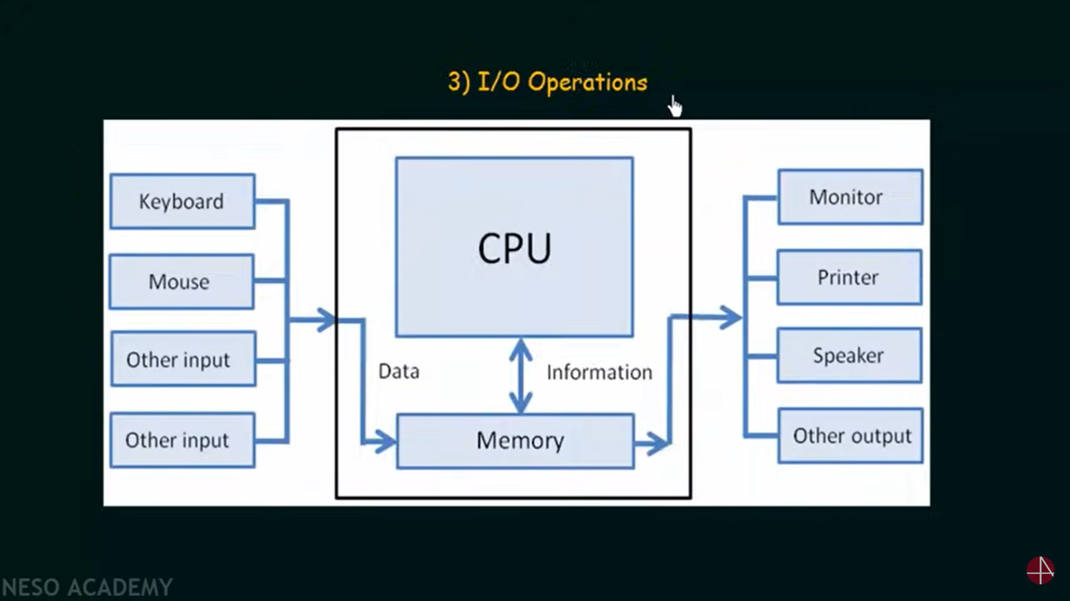

Slide 53
I/O Operations
Running program may require I/O such as file or I/O device

Slide 54
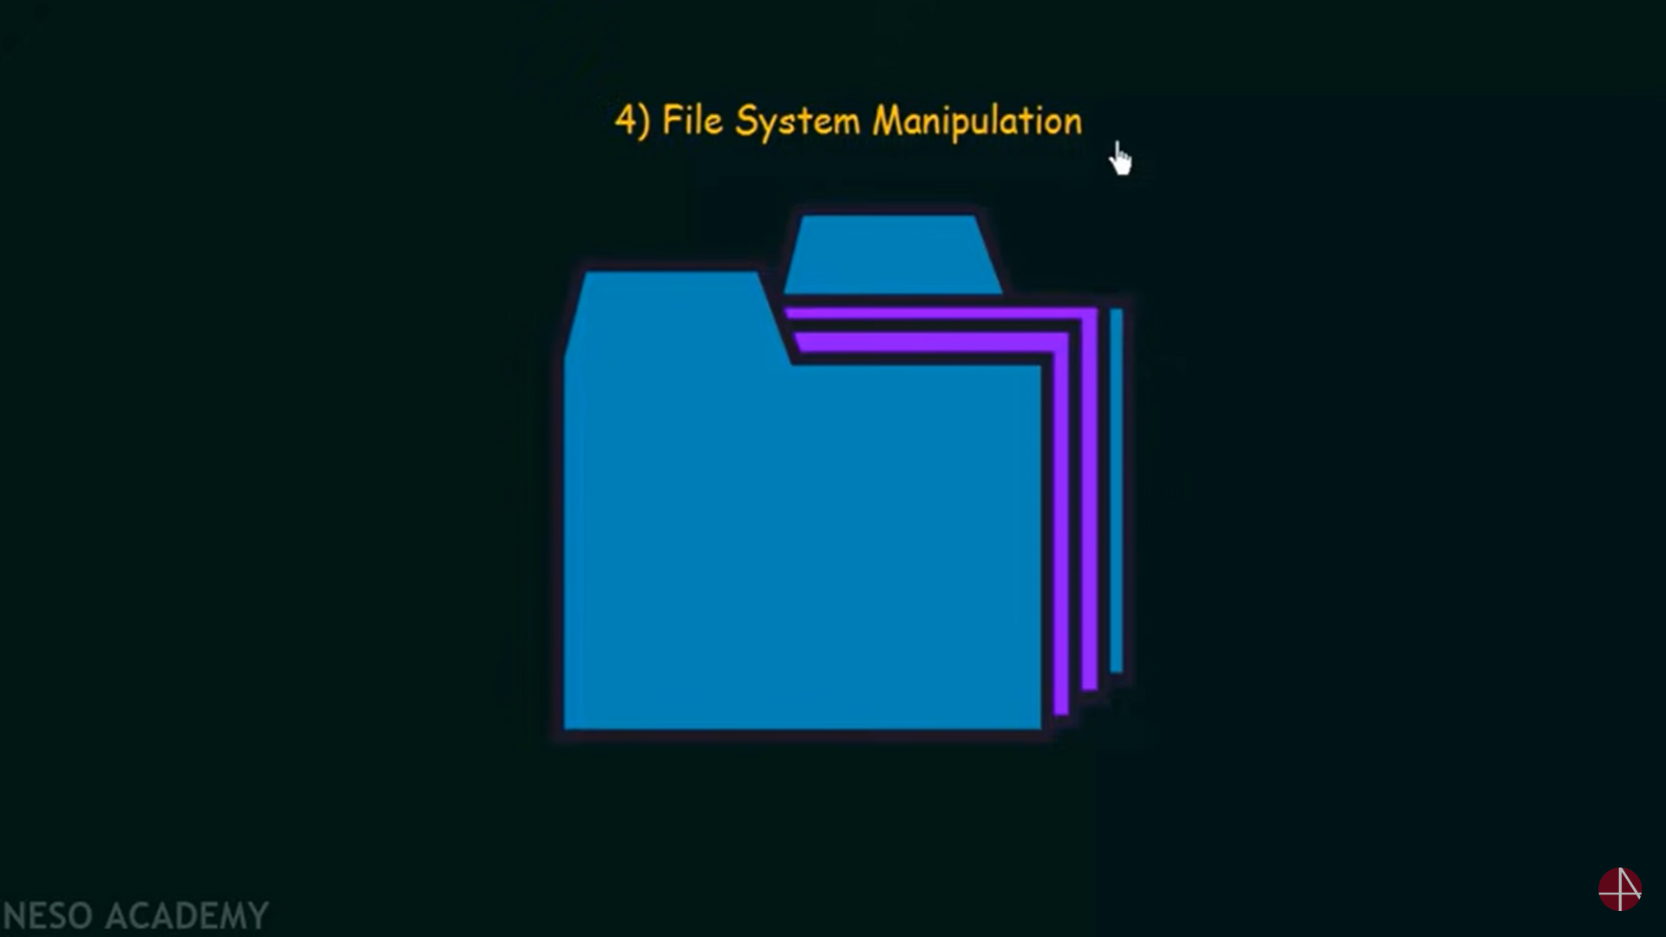

Slide 55
File System Manipulation
Read, write, create and delete files and directories
Search or list files and directories
Permission management

Slide 56
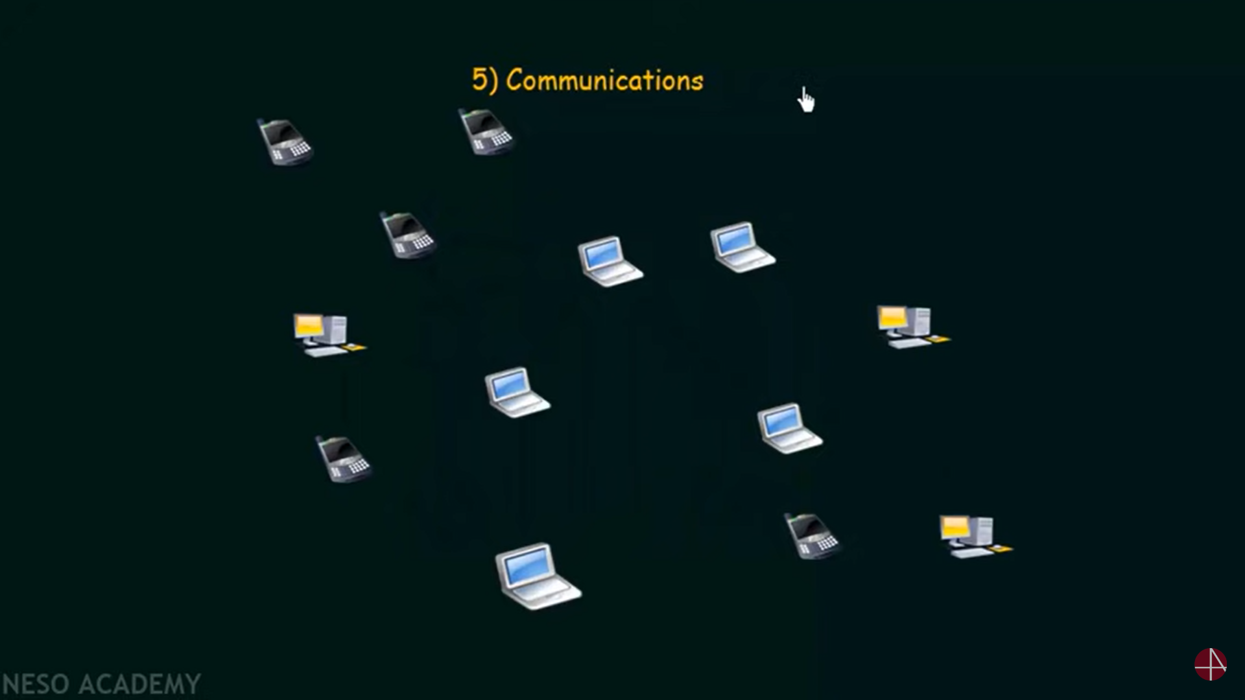

Slide 57
Communication
Processes exchange information, on the same system or over a network
via shared memory or through message passing

Slide 58
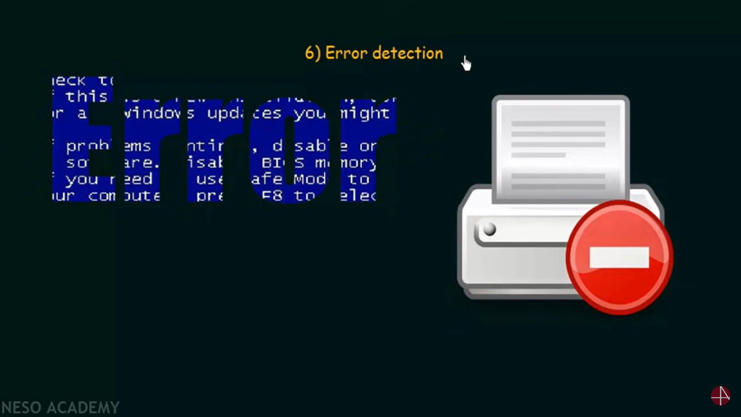

Slide 59
Error Detection
OS needs to be constantly aware of possible errors
Errors in CPU, memory, I/O devices, programs
It should take appropriate actions to ensure correctness and consistency

Slide 60
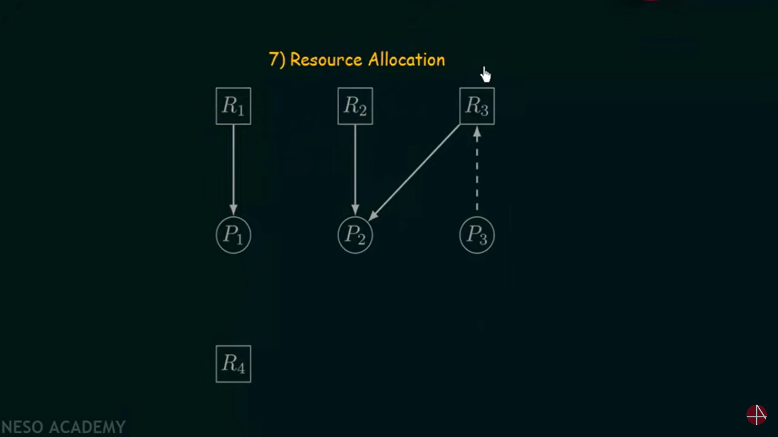

Slide 61
Resource Allocation
Allocate resources for multiple users or multiple jobs running concurrently
Many types of resources: CPU, memory, file, I/O devices

Slide 62
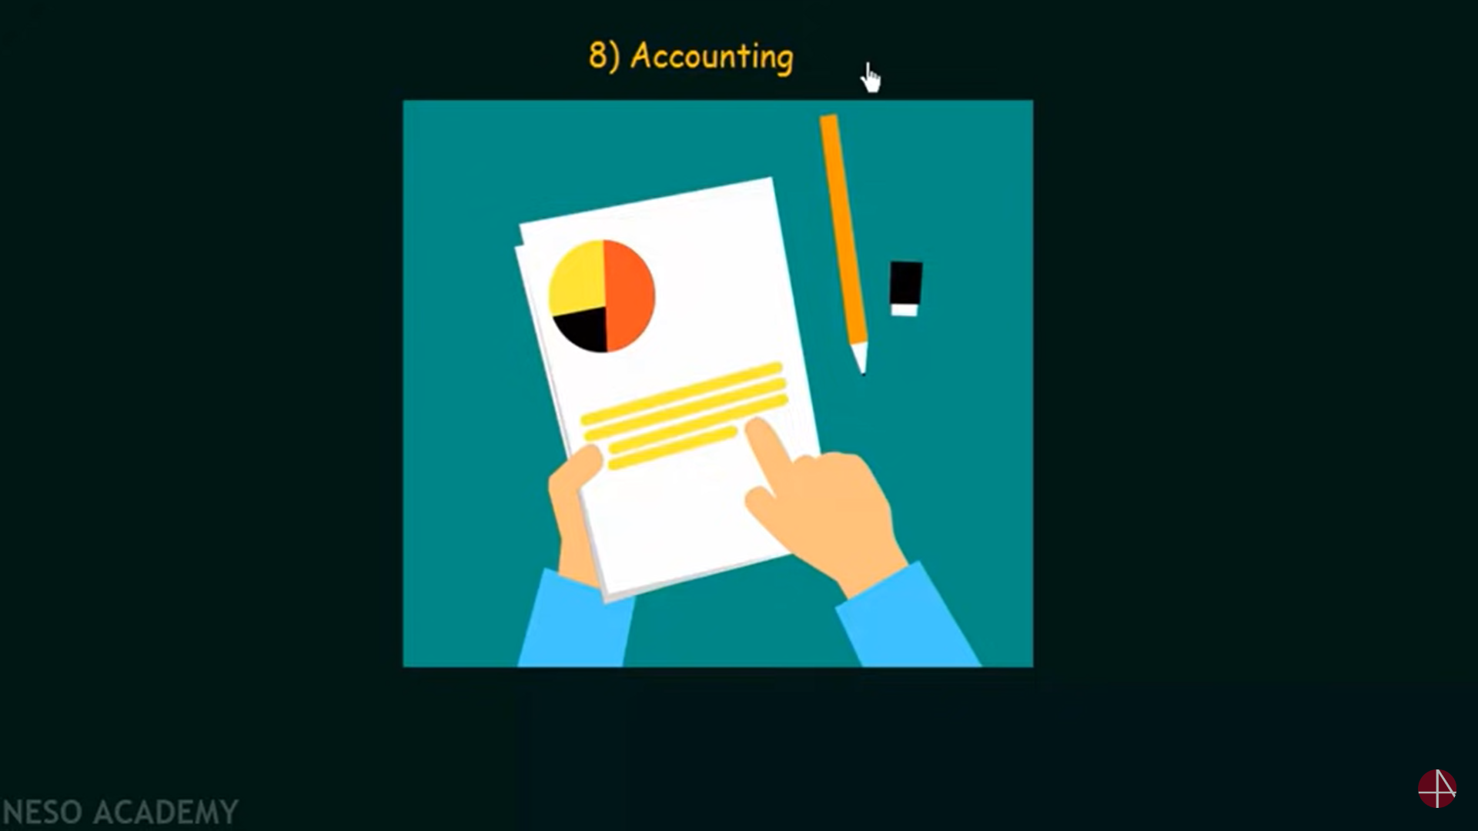

Slide 63
Accounting
To keep track of which users use how much and what kinds of resources

Slide 64
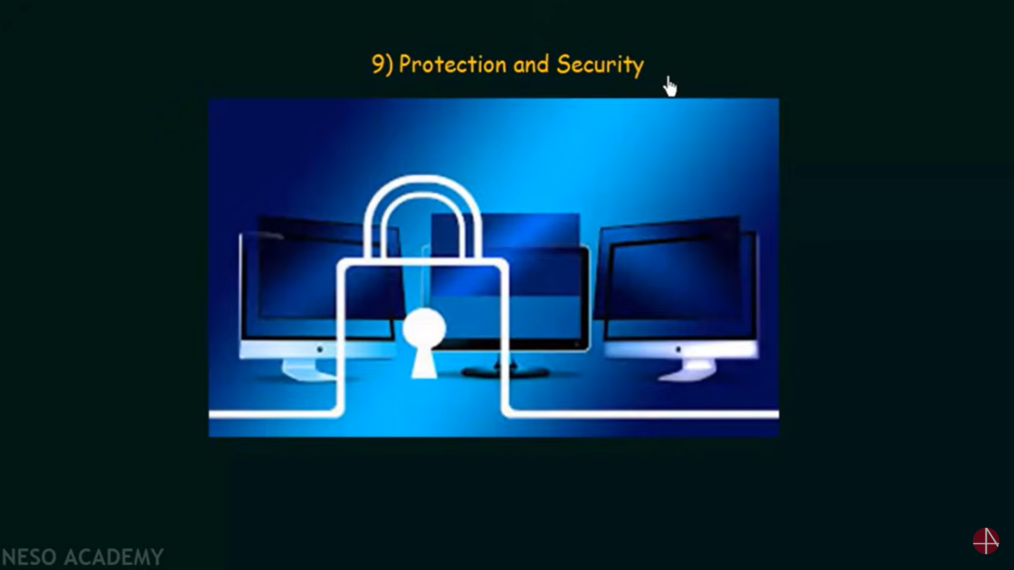

Slide 65
Protection and Security
Protection provides a mechanism to control access to system resources
access control: control access to resources
isolation: processes should not interfere with each other
Security authenticates users and prevent invalid access to I/O devices
Protection is the mechanism, security towards the policy

Slide 66
System Calls
Acts as an interface between the Kernel and User programs.
It provides services to the user program through OS via API.
Typically written in a high-level language (C or C++)
Three most common APIs are Win32 API for Windows, POSIX API for POSIX-based systems (including virtually all versions of UNIX, Linux, and Mac OS X), and Java API for the Java virtual machine (JVM)
Notes:
66

Slide 67
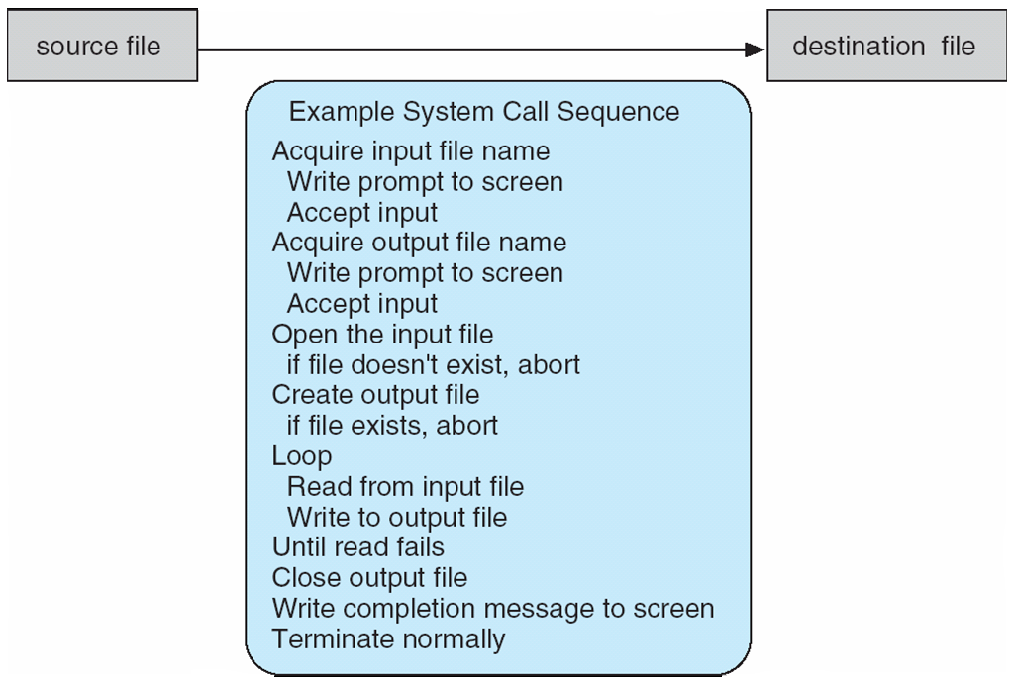
Example of System Calls
System call sequence to copy the contents of one file to another file
Notes:
67

Slide 68
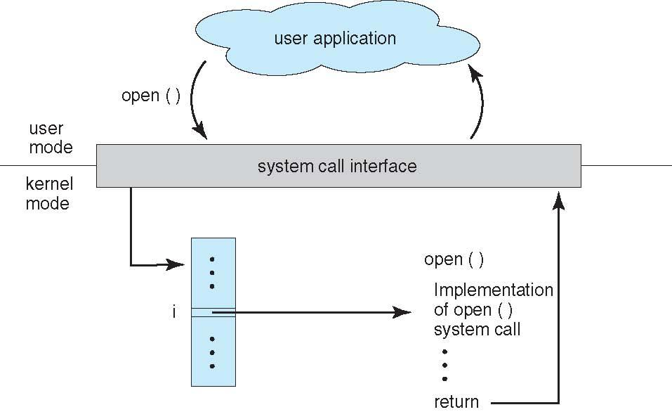
API – System Call – OS Relationship
Notes:
68

Slide 69
Types of System Calls
Process control
create process, terminate process
end, abort
load, execute
get process attributes, set process attributes
wait for time
wait event, signal event
allocate and free memory
Debugger for determining bugs, single step execution
Locks for managing access to shared data between processes
Notes:
69

Slide 70
Types of System Calls
File management
create file, delete file
open, close file
read, write, reposition
get and set file attributes
Device management
request device, release device
read, write, reposition
get device attributes, set device attributes
logically attach or detach devices
Notes:
70

Slide 71
Types of System Calls (Cont.)
Information maintenance
get time or date, set time or date
get system data, set system data
get and set process, file, or device attributes
Communications
create, delete communication connection
send, receive messages if message passing model to host name or process name
From client to server
Shared-memory model create and gain access to memory regions
transfer status information
attach and detach remote devices
Notes:
71

Slide 72
Types of System Calls (Cont.)
Protection
Control access to resources
Get and set permissions
Allow and deny user access
Notes:
72

Slide 73
Process Concept
An operating system executes a variety of programs:
Batch system – jobs
Time-shared systems – user programs or tasks
Terms job and process almost interchangeably

Slide 75
Process Concept
Process – a program in execution; process execution must progress in sequential fashion
Multiple parts
The program code, also called text section
Current activity including program counter, processor registers
Stack containing temporary data
Function parameters, return addresses, local variables
Data section containing global variables
Heap containing memory dynamically allocated during run time

Slide 76
Process Concept (Cont.)
Program is passive/Static entity stored on disk (executable file), process is active /Dynamic
Program becomes process when executable file loaded into memory
Execution of program started via GUI mouse clicks, command line entry of its name, etc
One program can be several processes
Consider multiple users executing the same program

Slide 77
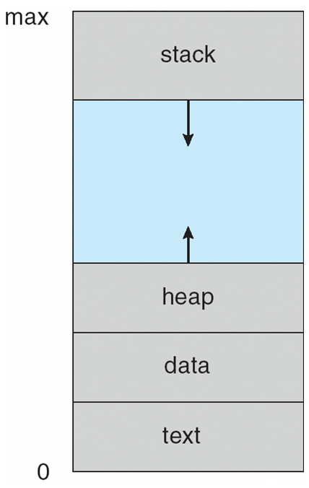
Process in Memory

Slide 78
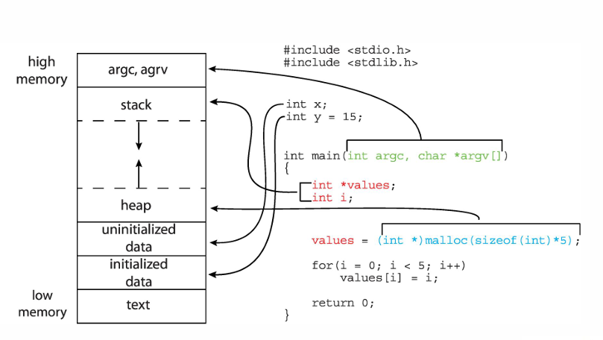

Slide 79
Process State
As a process executes, it changes state
new: The process is being created
running: Instructions are being executed
waiting: The process is waiting for some event to occur
ready: The process is waiting to be assigned to a processor
terminated: The process has finished execution

Slide 80
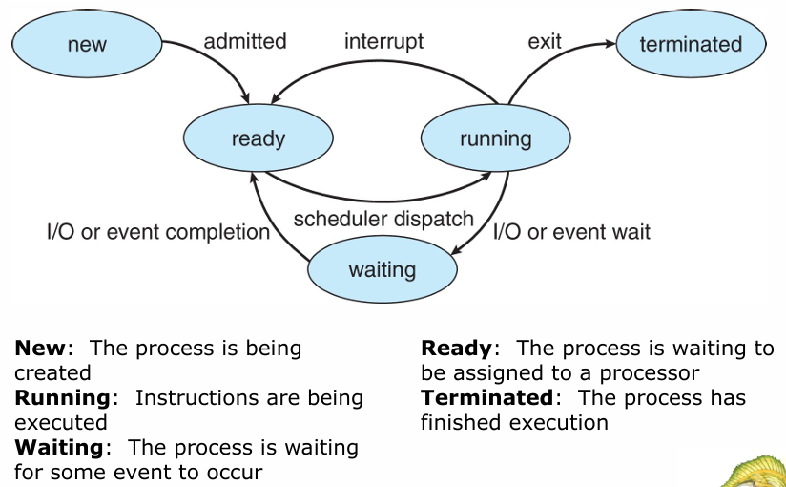
Diagram of Process State

Slide 81
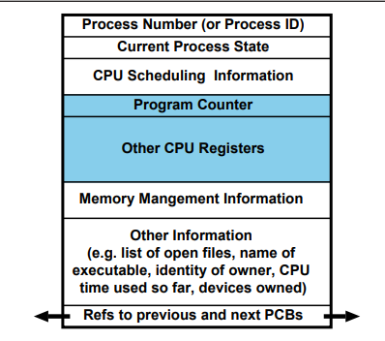
OS maintains information about every process in a data structure called a Process Control Block (PCB).

Slide 82
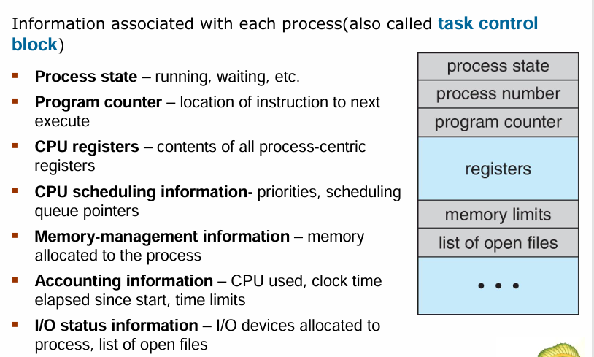
Process Control Block (PCB)

Slide 83
Context Switching
Process Context = machine environment during the time the process is actively using the CPU.
Context includes program counter, general purpose registers, processor status register.
To switch between processes, the OS must:
a) save the context of the currently executing process (if any),
b) restore the context of that being resumed
Time taken depends on h/w support.

Slide 84
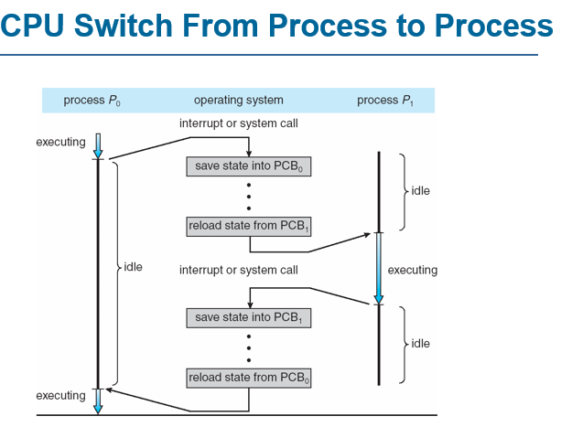

Slide 85
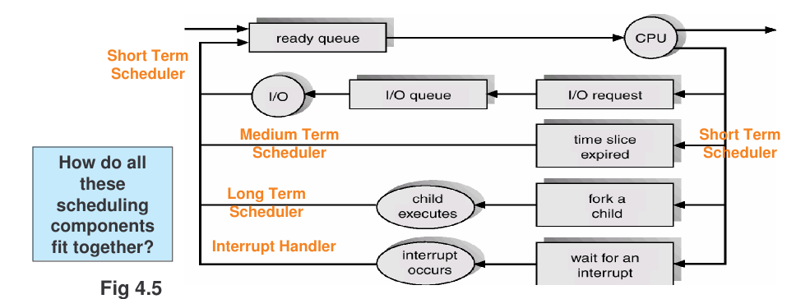
INTERRUPT HANDLER

Slide 86
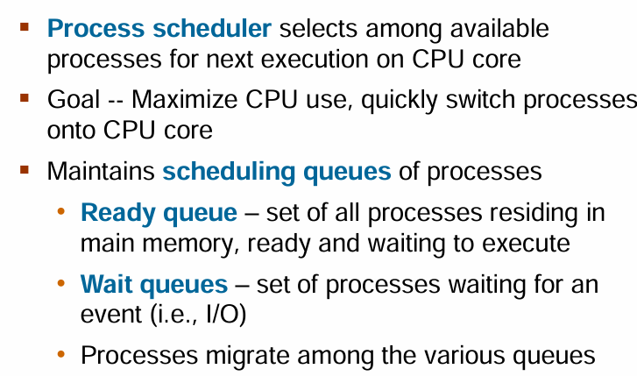
Process Scheduling

Slide 87
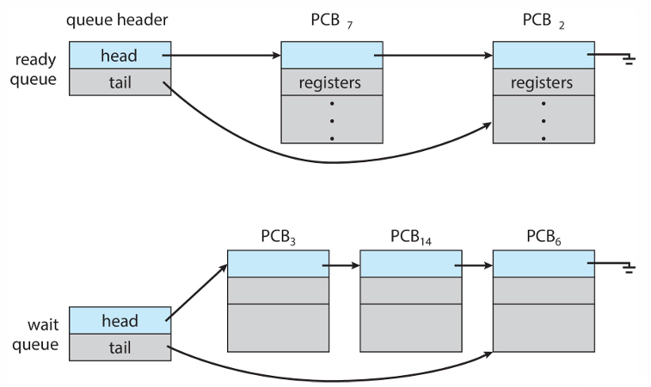
Ready Queue and Wait Queue

Slide 88
Scheduling Queues
Job Queue
Ready Queue
admit
dispatch
CPU
release
timeout or yield
Wait Queue(s)
event
event-wait
create create (batch) (interactive)
Job Queue: batch processes awaiting admission.
Ready Queue: set of all processes residing in main memory, ready to execute.
Wait Queue(s): set of processes waiting for an I/O device (or for other processes)
Long-term & short-term schedulers:
Job scheduler selects which processes should be brought into the ready queue.
CPU scheduler decides which process should be executed next and allocates the CPU to it.
Operating Systems — Process Life-cycle

Slide 89
Process Creation
Nearly all systems are hierarchical : parent processes create children processes.
Resource sharing:
parent and children share all resources, or
children share subset of parent’s resources, or
parent and child share no resources.
Execution:
parent and children execute concurrently, or
parent waits until children terminate.
Address space:
child is duplicate of parent or
child has a program loaded into it.
e.g. on Unix: fork() system call creates a new process
all resources shared (i.e. child is a clone).
execve() system call used to replace process’ memory with a new program.
Operating Systems — Process Life-cycle

Slide 90
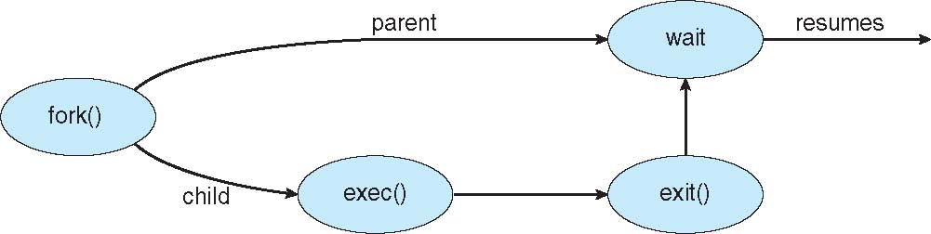
Process Creation (Cont.)
UNIX examples
fork() system call creates new process
exec() system call used after a fork() to replace the process’ memory space with a new program

Slide 92
Process Termination
Process executes last statement and asks the operating system to delete it (exit):
output data from child to parent (wait)
process’ resources are deallocated by the OS.
Process performs an illegal operation, e.g.
makes an attempt to access memory to which it is not authorised,
attempts to execute a privileged instruction
Parent may terminate execution of child processes (abort, kill), e.g. because
child has exceeded allocated resources
task assigned to child is no longer required
parent is exiting (“cascading termination”)
(many operating systems do not allow a child to continue if its parent terminates)
e.g. Unix has wait(), exit() and kill()

Slide 93
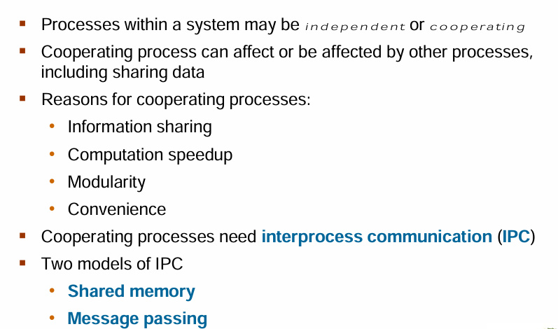
Inter process Communication

Slide 94
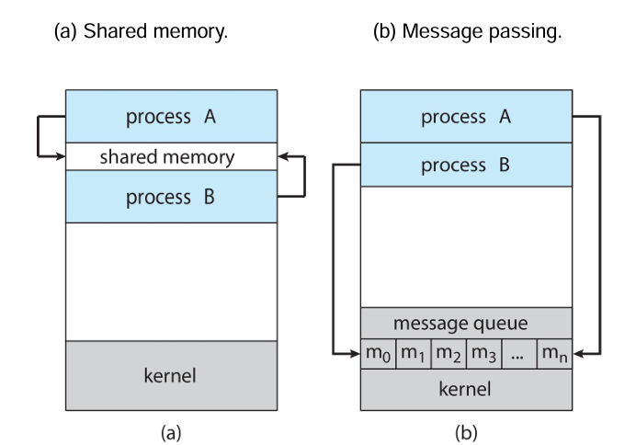
Communications Models

Slide 95
Example of Cooperative processes:
Producer-Consumer problem.
Unbounded buffer or bounded buffer
Buffer can be provided by OS (i.e., message-passing) e.g., pipe()
Buffer can be programmed in the cooperative processes (i.e., shared memory)

Slide 96
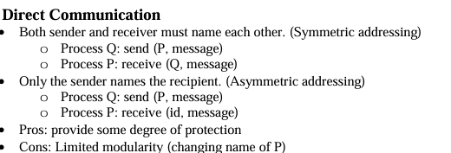

Slide 97
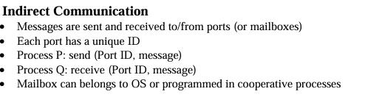

Slide 98

CPU Scheduling

Slide 99


Slide 100
CPU-I/O Burst Cycle
Frequency
2 4 6 8 10 12 14
CPU Burst Duration (ms)
16
CPU-I/O Burst Cycle: process execution consists of an on-going cycle of CPU execution, I/O wait, CPU execution, . . .
Processes can be described as either:
I/O-bound: spends more time doing I/O than computation; has many short CPU bursts.
CPU-bound: spends more time doing computations; has few very long CPU bursts.
Observe most processes execute for at most a few milliseconds before blocking
⇒ need multiprogramming to obtain decent overall CPU utilization.
Operating Systems — Process Life-cycle

Slide 101

CPU Scheduler

Slide 102

Dispatcher

Slide 103

Scheduling Criteria
Operating Systems — CPU Scheduling

Slide 104
Scheduling Algorithm Optimization Criteria
Max CPU utilization
Max throughput
Min turnaround time
Min waiting time
Min response time

Slide 105
Types of CPU Scheduling
First Come First Serve
Shortest Job First-Non-Preemptive
Shortest Job First-Preemptive
Round Robin
Priority Scheduling
https://www.youtube.com/watch?v=AiVKIdGheEU&list=PLIY8eNdw5tW_lHyageTADFKBt9weJXndE&index=1

Slide 106


Slide 107


Slide 108


Slide 109


Slide 110

Short Job First Scheduling

Slide 111


Slide 112


Slide 113

Shortest Job First -Preemptive

Slide 114


Slide 115

Round Robin Scheduling

Slide 117


Slide 118

Priority Scheduling

Slide 119


